Slide 1

Welcome to
Upper School 2023-2024

Slide 2
The Upper School Team
Teachers
Miss Edwards-King (Amazon) Miss Hannah (Daintree) Mr Edwards (Redwood)
Mrs Peyton (cover) Mrs Woodley (cover)
Teaching Assistants
Ms Bassett, Mrs Jersynska, Mrs Jacobs, Mrs Welsh, Ms Grimes, Mrs Abbott, Miss Bell
PPA staff
Mr Skingsley, Miss Flack (PE) Mr Brinsdon (Music)

Slide 3
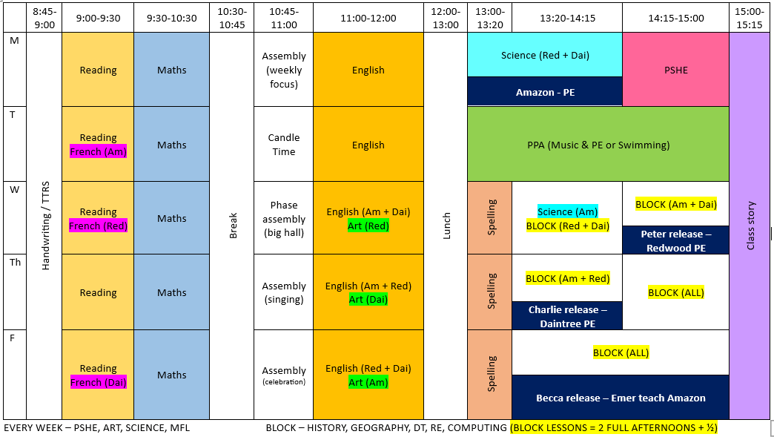
Example timetable
PE days:
Amazon –
Monday/Wednesday and Tuesday
Daintree –
Tuesday and Thursday
Redwood –
Tuesday and Wednesday

Slide 4
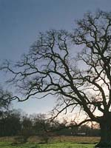
Curriculum and visits
This term our topic is called Resilience – it centres mainly around our history unit on WWII.
Our curriculum is planned over a two-year cycle to ensure all children cover Year 5 and 6 objectives.
Maths, English and Science will also be linked to the topic as appropriate.
This term we have planned a visit to the RAF museum this Thursday (14th September).

Slide 5

Reading habits and Planners
This year we are focusing on developing great reading habits!
The children must bring their planner to and from school every day.
Planners will be signed by the class teacher on a Friday and should be signed by someone at home by Monday the following week.
Record of house points, diary, reading record, homework, spellings.
Important reference resource in lessons.

Slide 6
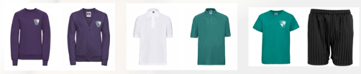
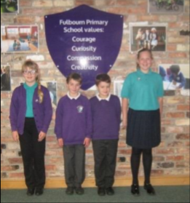
Uniform
Purple jumper and jade green or white shirt – no hooded jumpers
Grey or black skirt, dress or trousers
Black trainers/shoes
Wrist watches are welcome (no smart watches please).
Earrings must be studs (and removed for PE)
Children have breaks outside, even if it’s raining, so please provide a coat.

Slide 7

Homework
Spelling and times table homework be assigned weekly on a Wednesday.
We will have tests for spellings and times tables each week.
Each half term, your child will take home a menu of activities which cover all other areas of the curriculum. These can all be brought in at the end of half term to be presented to the class and gain feedback.
Children will have an exercise book to complete their homework in which will be collected at the end of each half term.
In year 5/6 we will be using Atom learning as an additional homework resource.

Slide 8
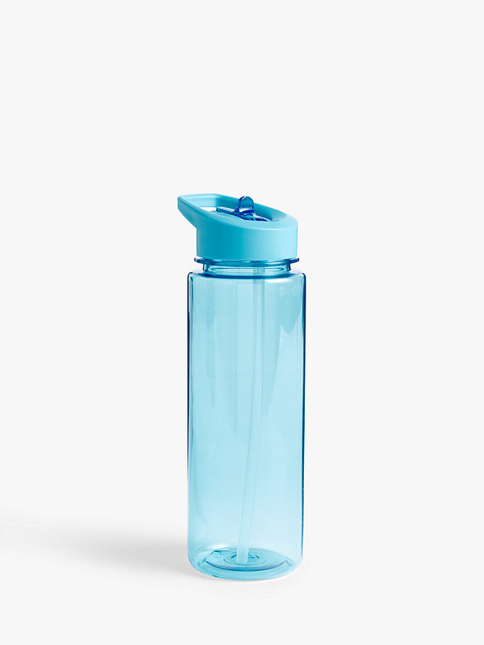
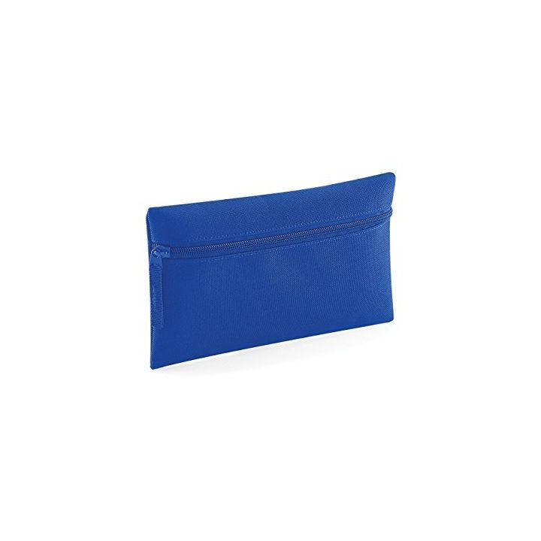

Practical matters
Every classroom has a reading corner, as well as a role play area and a discovery area.
Children may keep personal pencil cases in their drawers (they must fit!).
Everyone must bring their own water bottle and is responsible for taking it home each day.
All KS2 children can bring a healthy snack into school (remember no nuts or citrus).
The cloakroom is available to store bags, coats, lunch boxes and spare shoes (if needed).

Slide 9
Thanks for coming!
y5y6teachers@fulbourn.cambs.sch.uk

