Slide 1
Addition and subtraction in KS1
Maths Morning Workshop

Slide 2
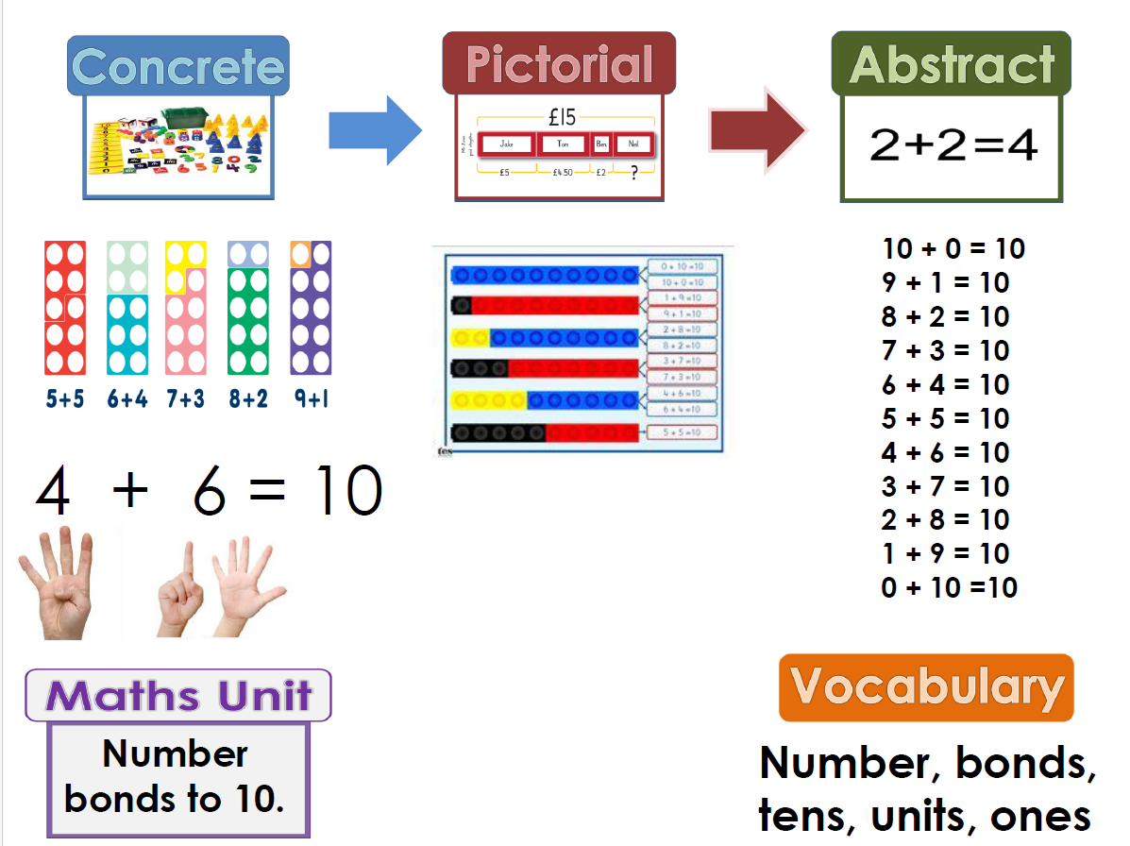
How do children learn mathematical concepts?
Children develop mathematical understanding by working with real world objects,
picture representations of these objects and finally by develop abstract concepts of numbers and their properties.

Slide 3
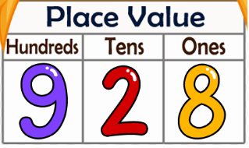
Place value
Place value refers to the value of each digit in a number.
Children need to understand place value to be able to add and subtract numbers.
Place value informs addition and subtraction.
How do you think place value informs these calculations:
23 + 21 48+13

Slide 4
Place value at home
Write a number and ask your child to tell you how many tens and ones there are in the number
Ask your child where a number would go on the number line. What number is before/after that number
Compare two numbers, which is greater/smaller?

Slide 5
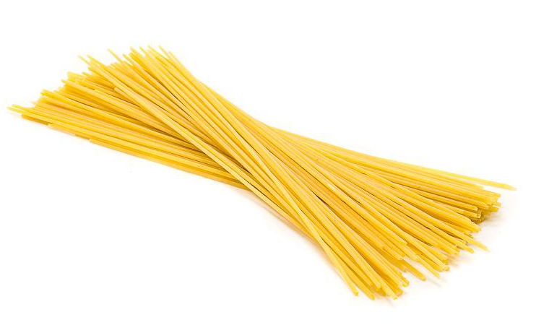
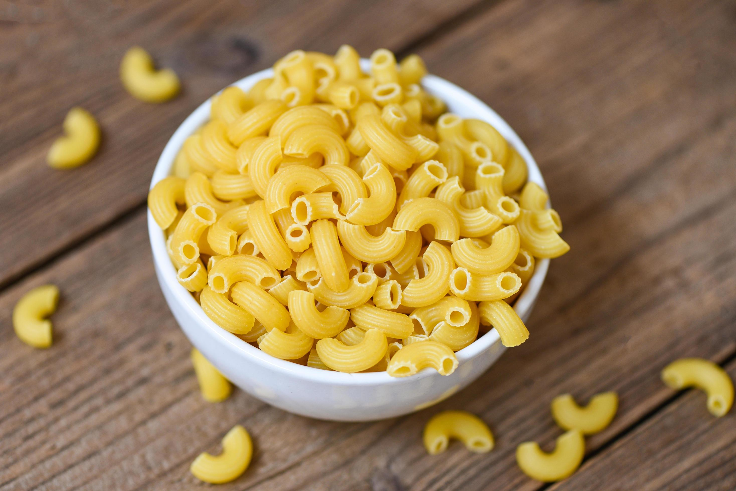
Tens and ones at home
When doing additions/subtractions you can represent tens and ones using spaghetti and pasta!
You can ask the children to draw a long line for tens and a square or a circle for ones.

Slide 6
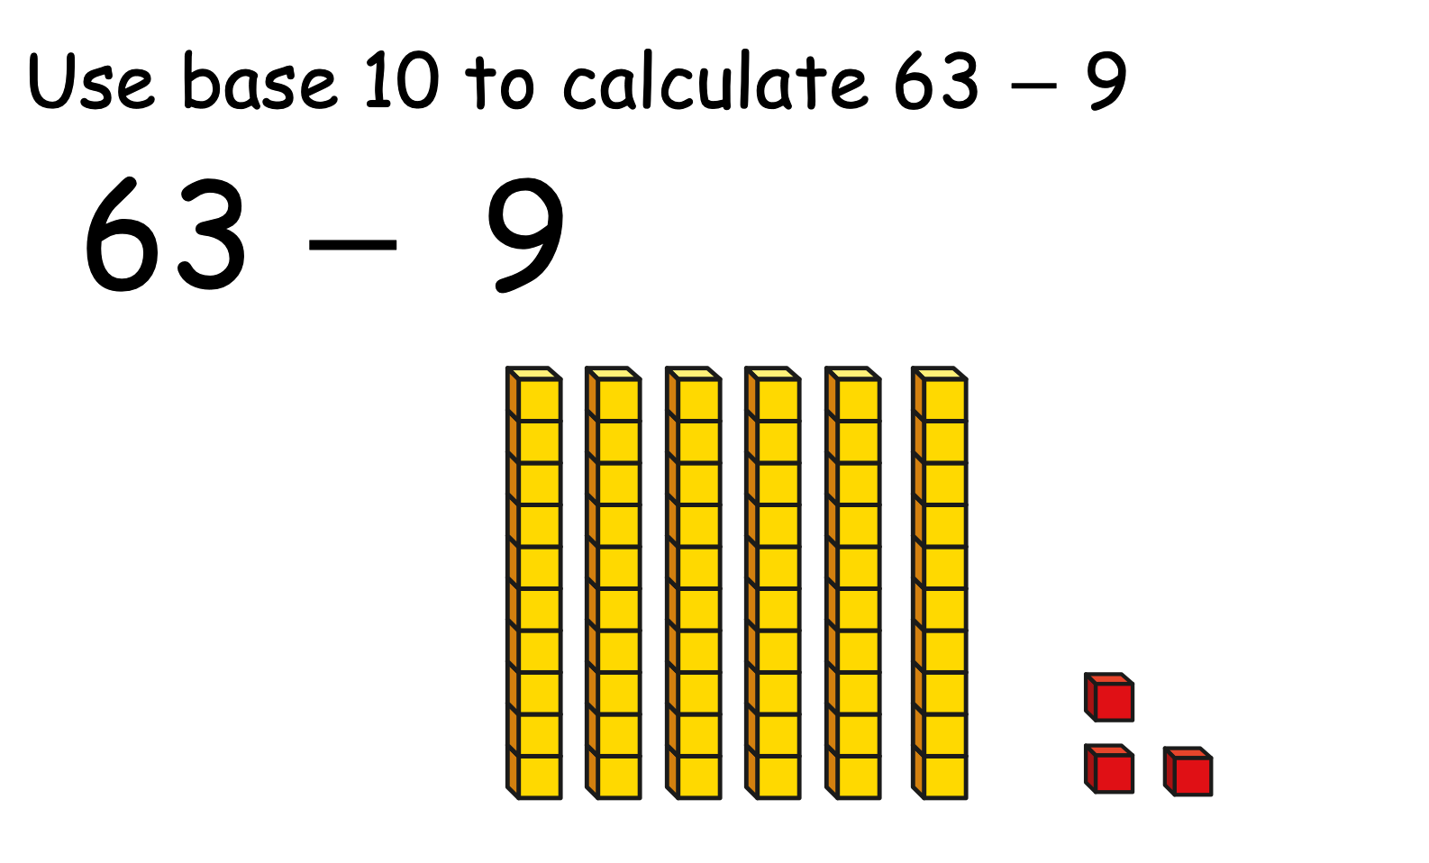
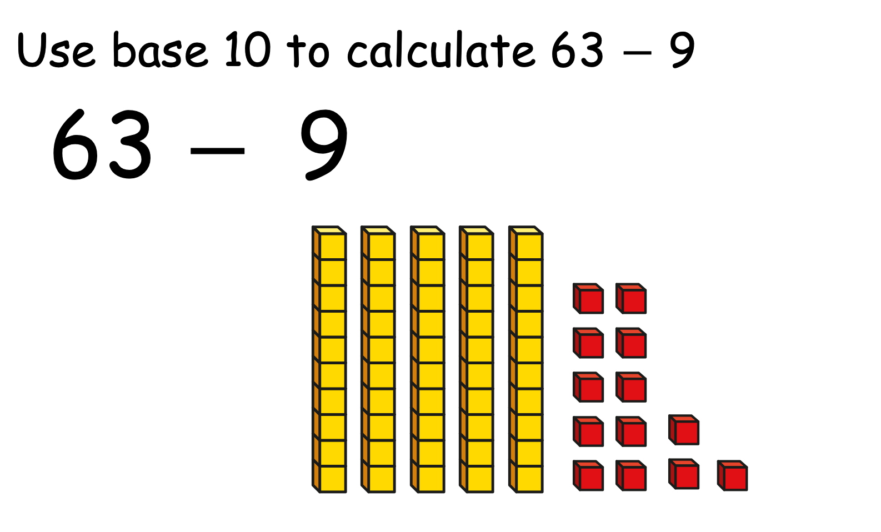
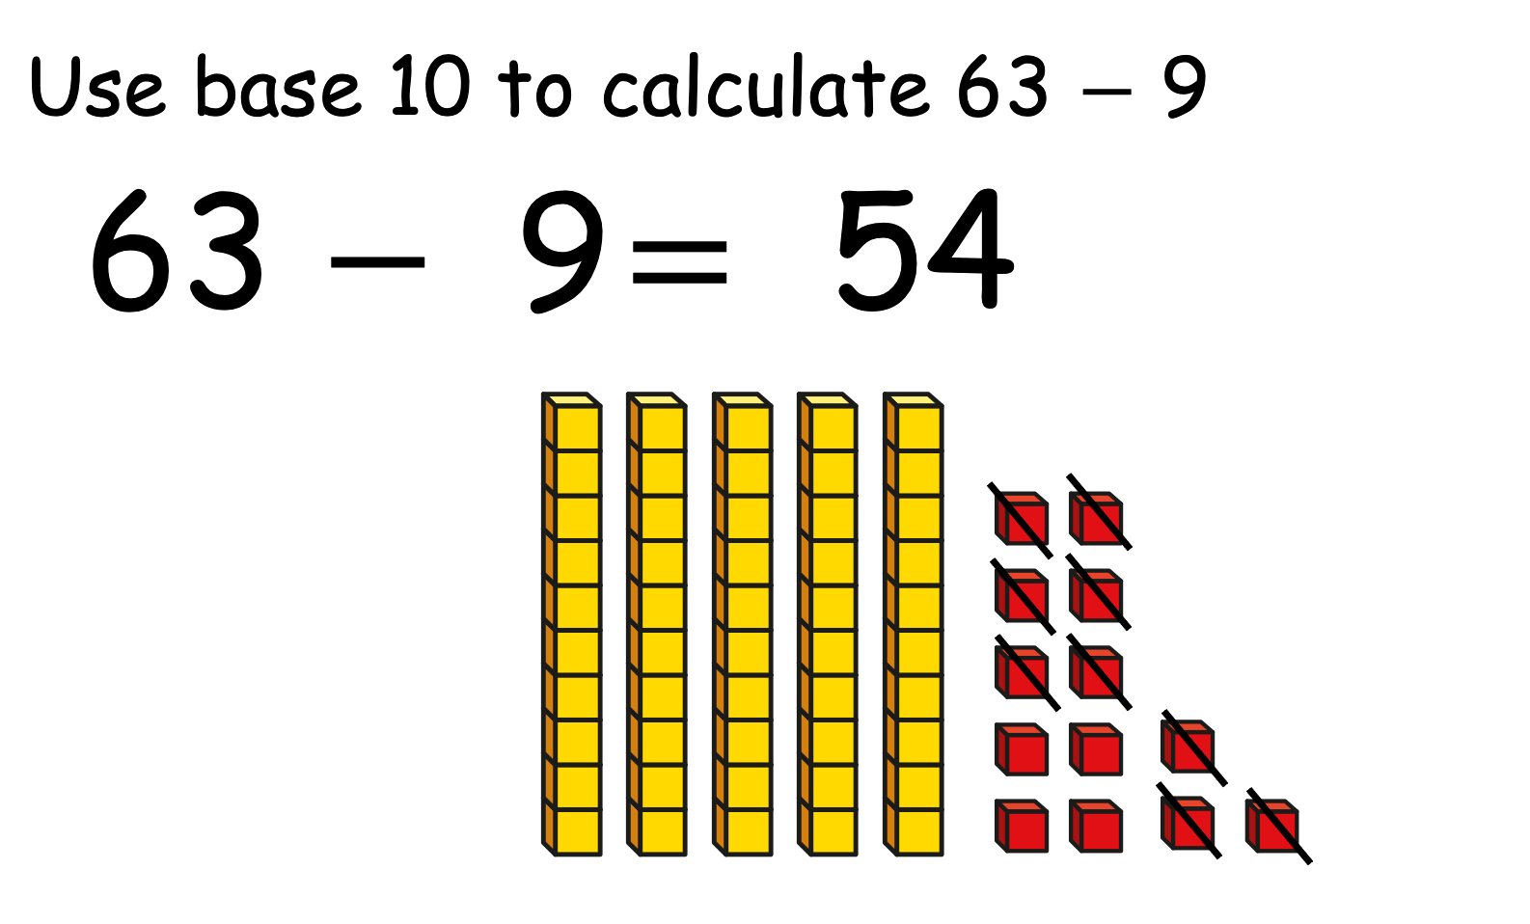
How we teach addition and subtraction in KS1

Slide 7
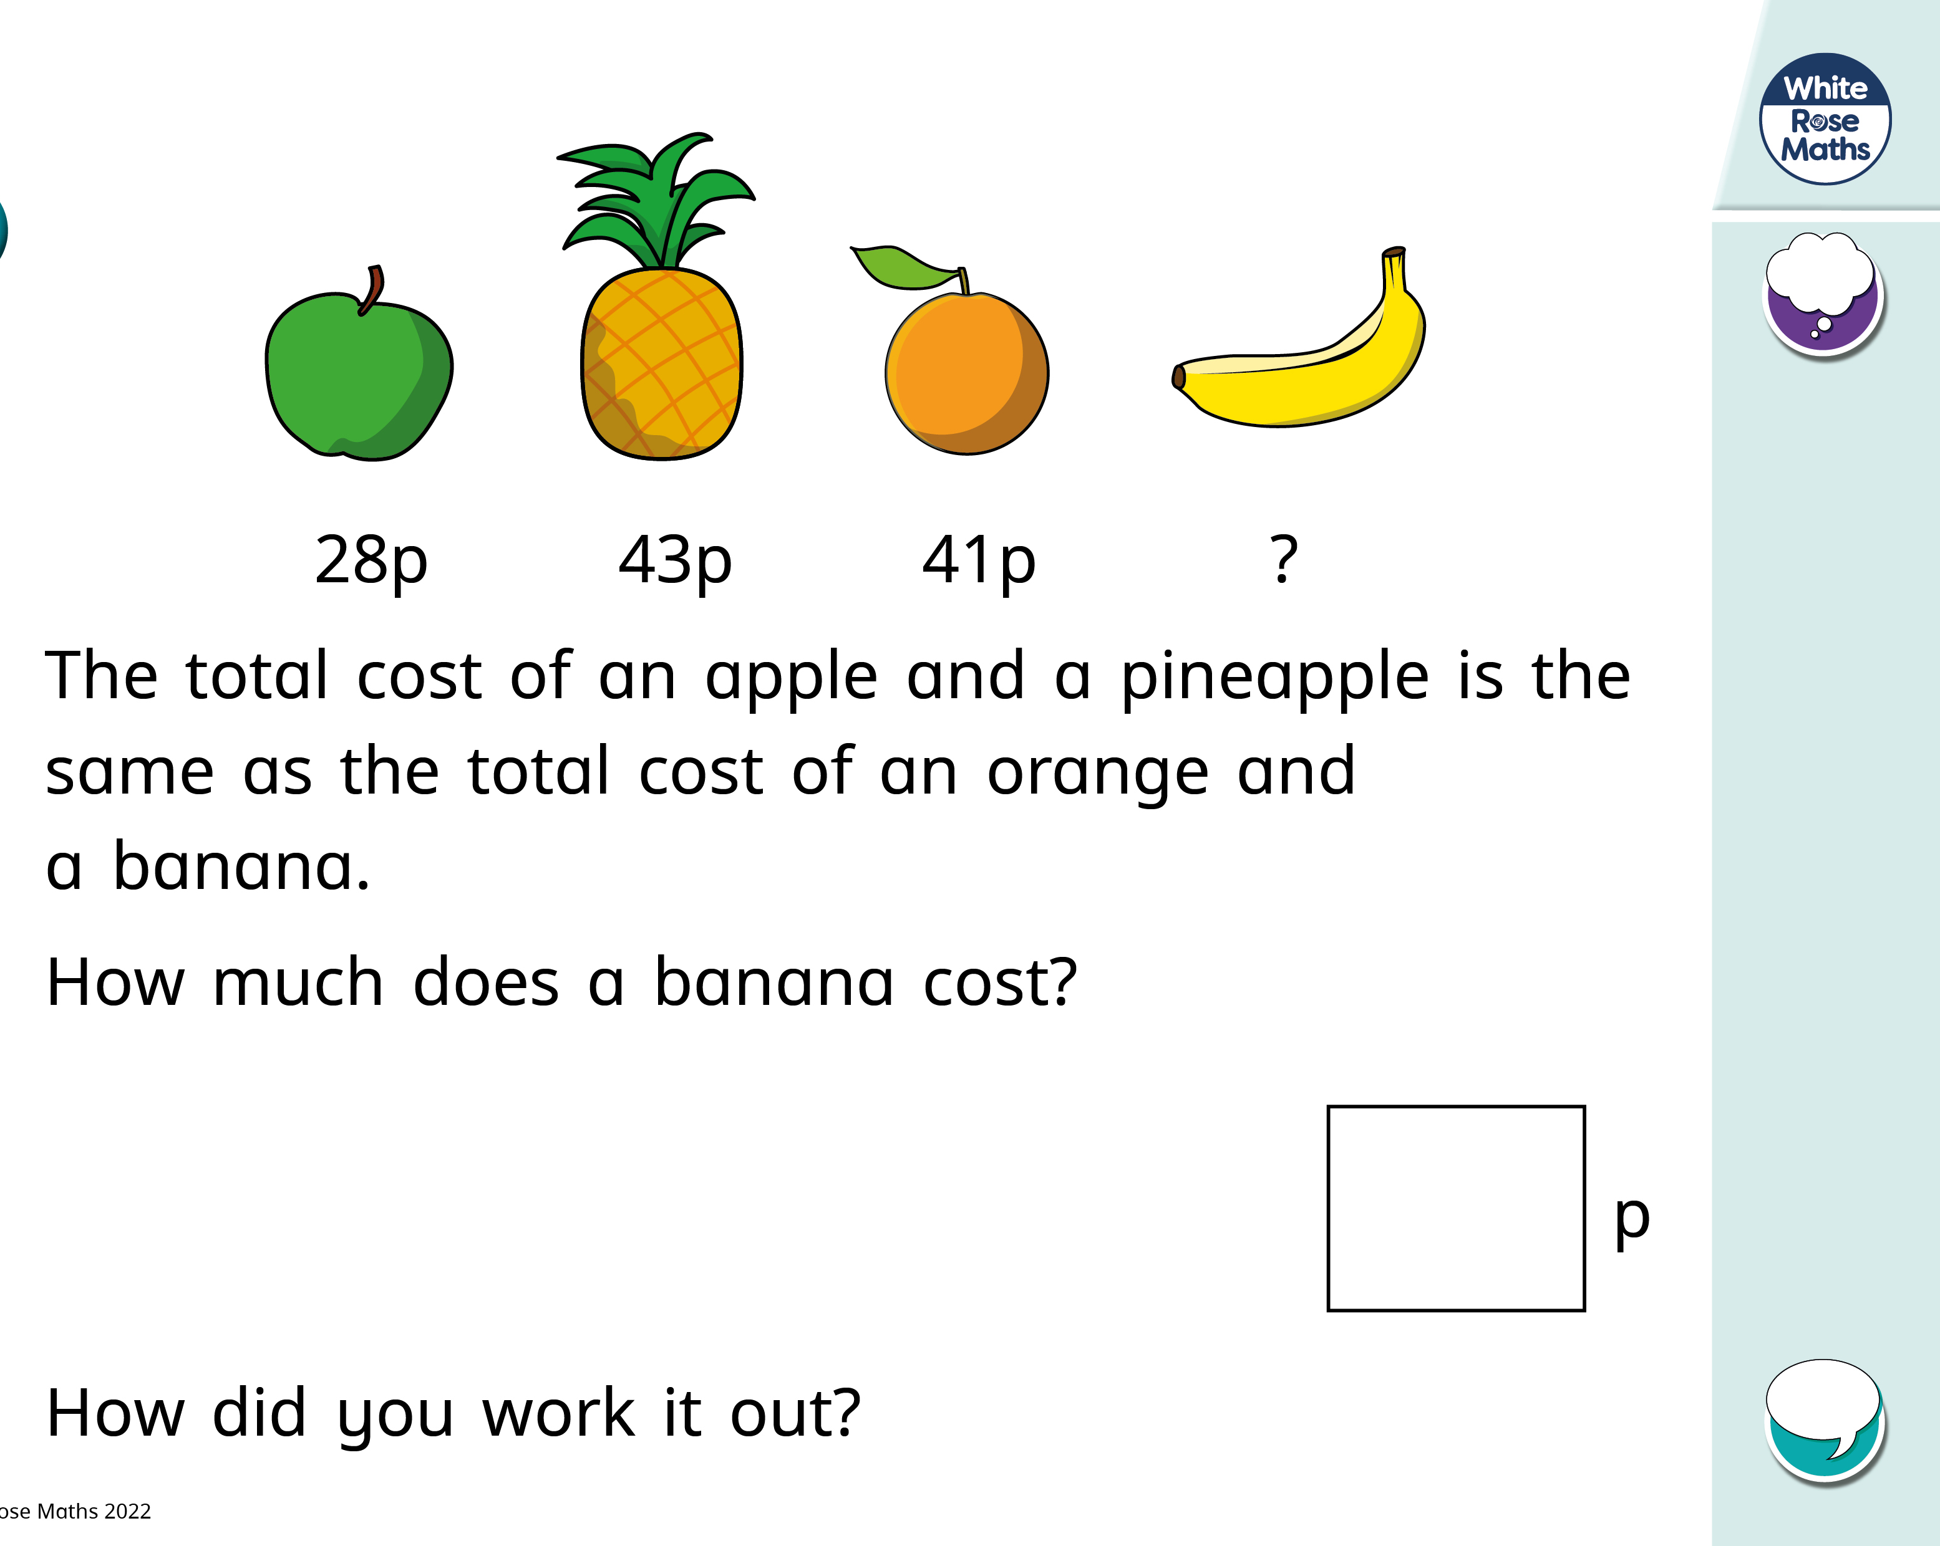
Examples of tasks

Slide 8
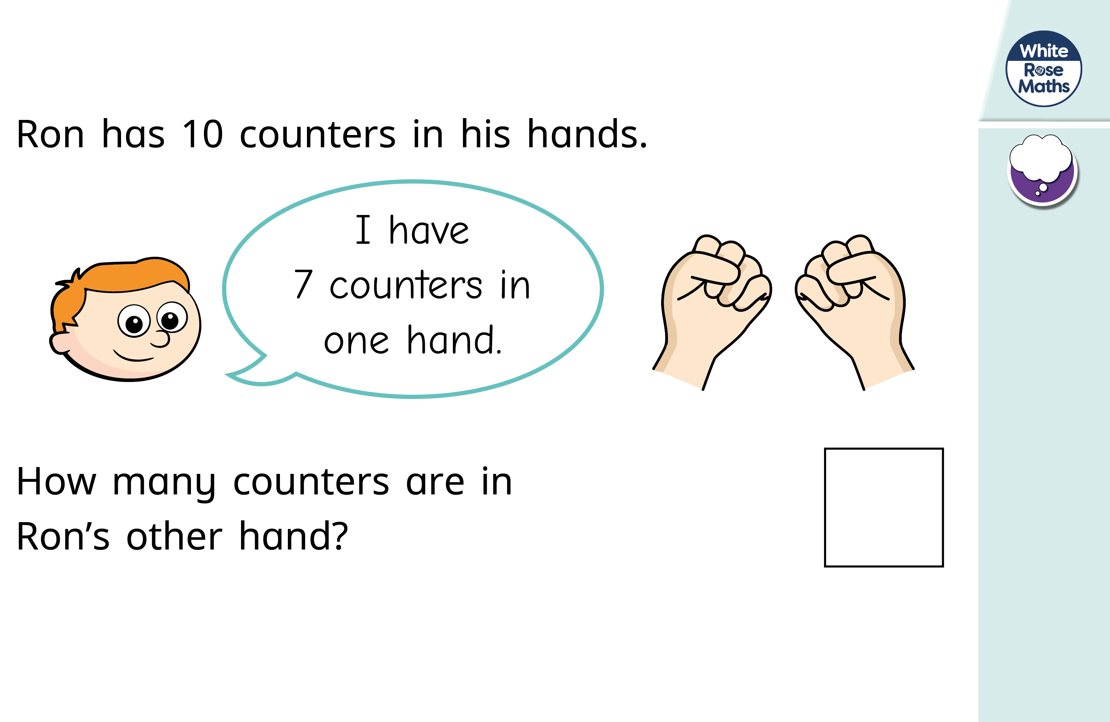
Examples of tasks

