Slide 1

Success in year 1
2024 - 25

Slide 2
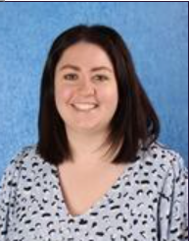
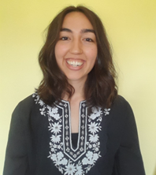
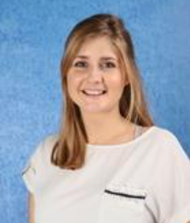
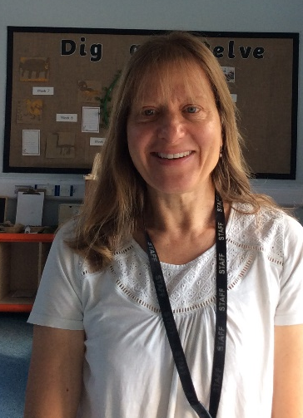
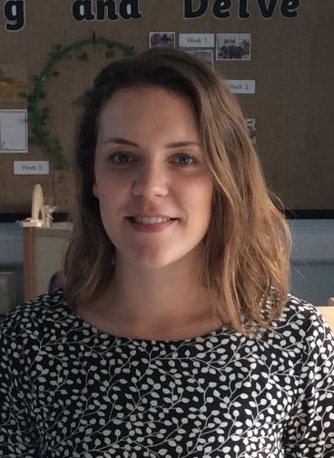
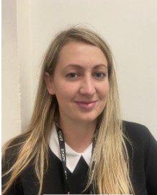
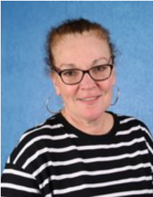
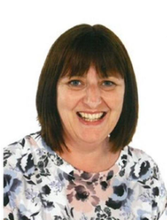
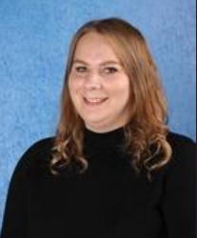
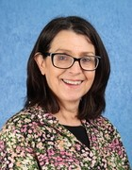
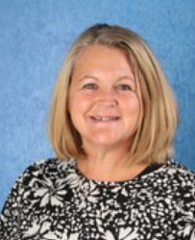
The Lower School Team
Harriet Robins
Adriatic Class Teacher
Emma Serle
Caribbean Class Teacher
Ali Richman
Lapland Class Teacher
(Mon-Wed)
Libby Meyer
Lapland Class Teacher
(Thurs-Fri)
Sarah Horsman
EYFS/KS1 Lead
Devon Trevillion Tami Gold Heather Taylor Gemma Nicholls Emer Peyton Sue Woodley
PPA staff: Dan Brinsdon (music) and Jamie Browne (PE)

Slide 3

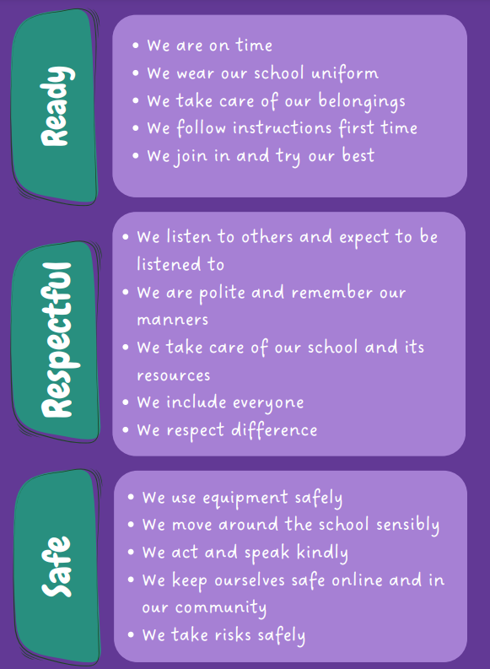

Slide 4
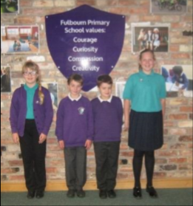
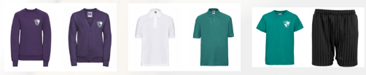
Uniform
Purple jumper and jade green or white shirt – no hooded jumpers
Grey or black skirt, dress or trousers
Plain black trainers/shoes
Wrist watches are welcome (no smart watches please).
Earrings must be studs (and must be removed for PE)
All playtimes are outside, even if it’s raining, so please provide waterproofs and a spare pair of shoes/wellies.
Please label everything!

Slide 5
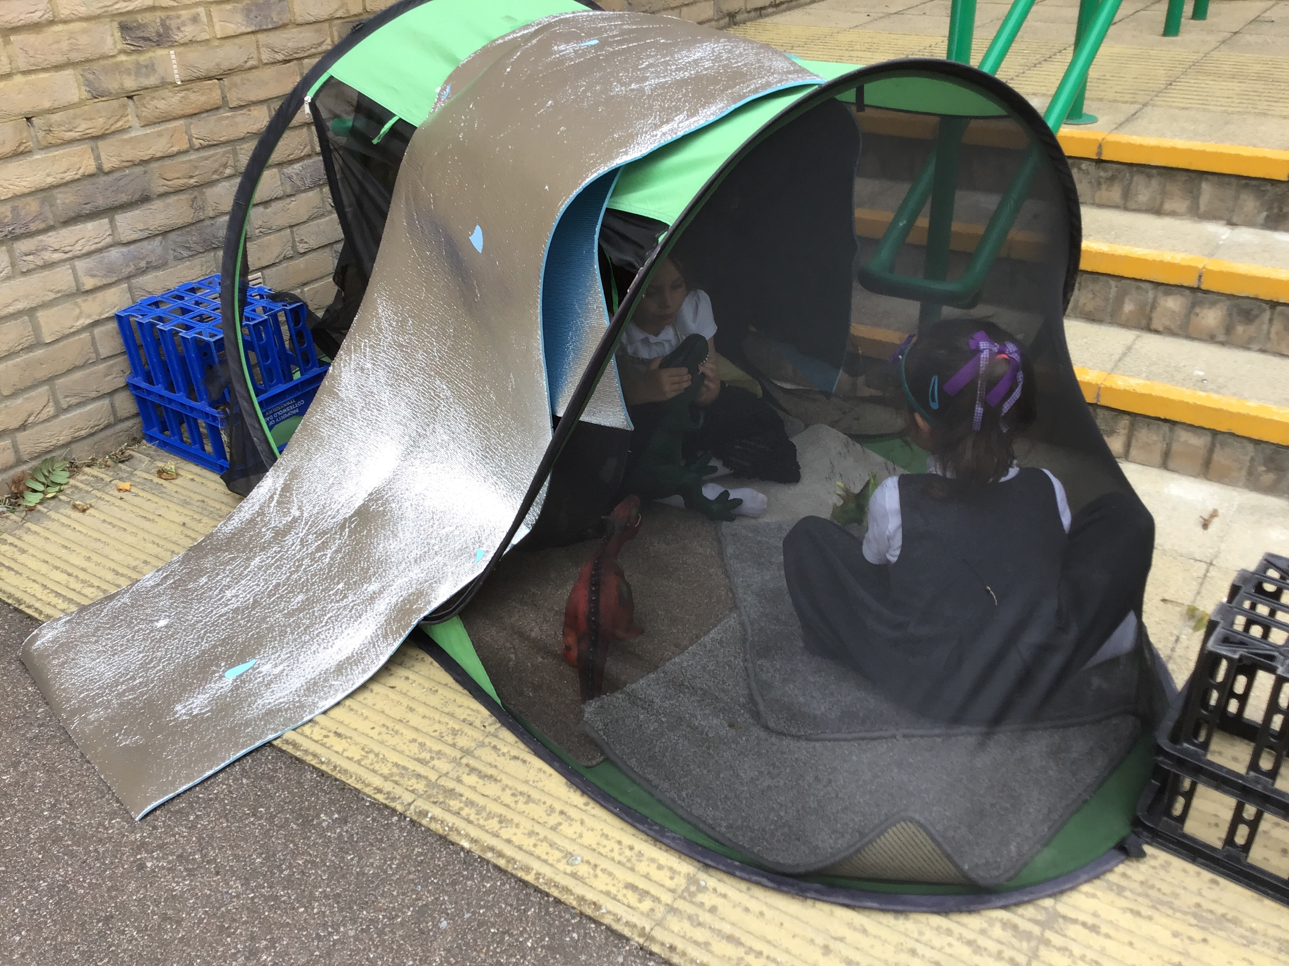
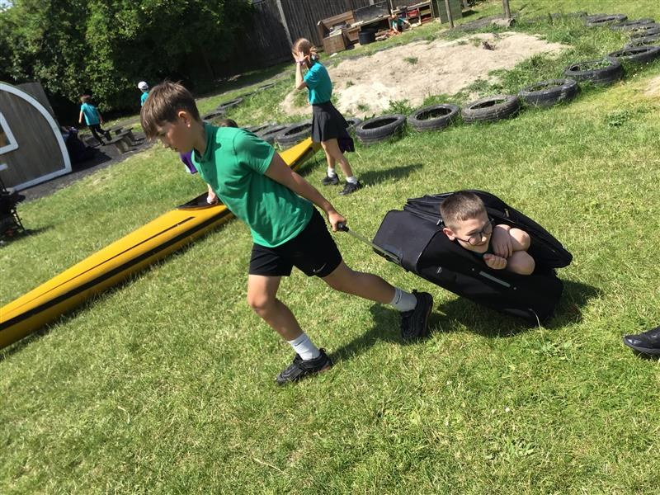
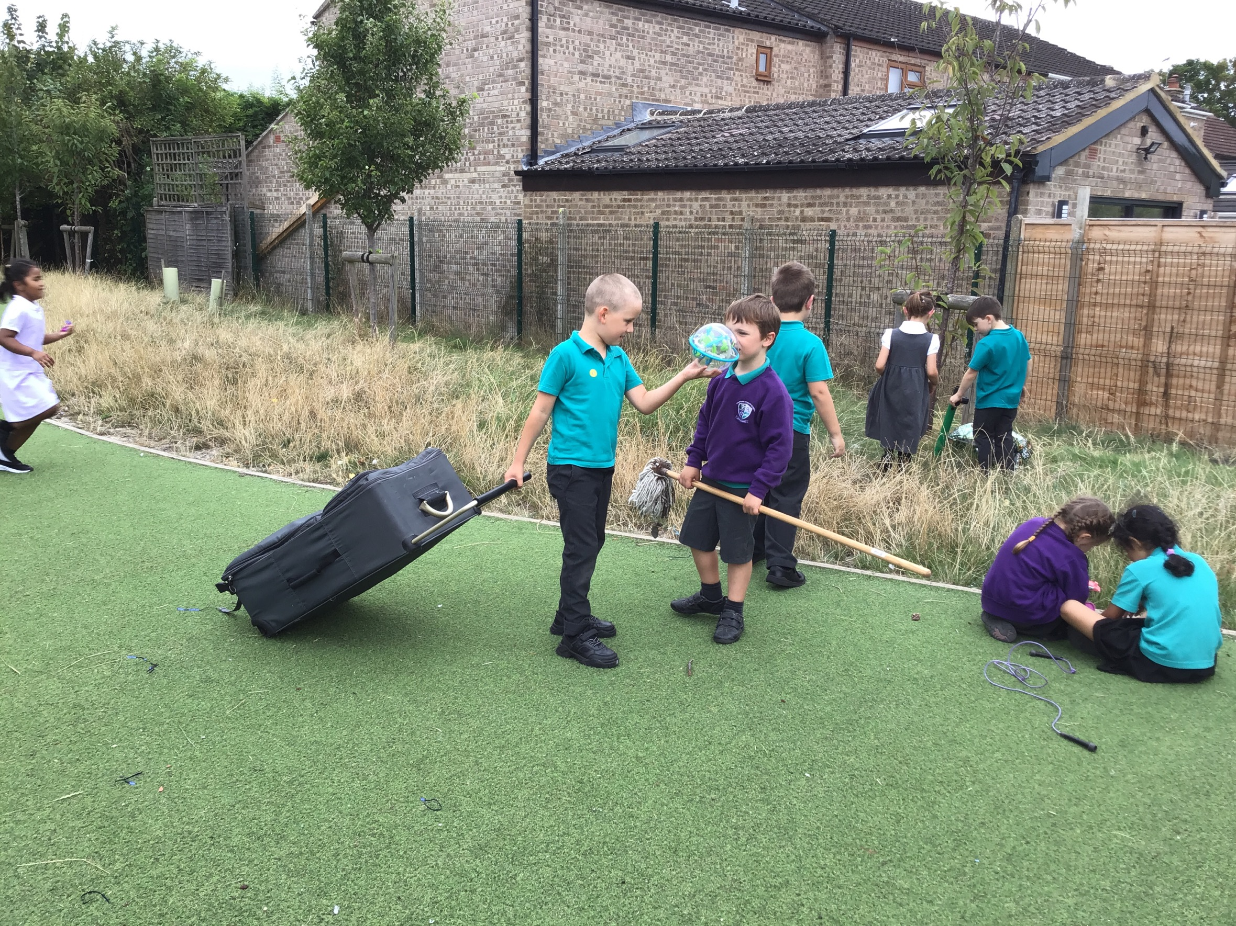
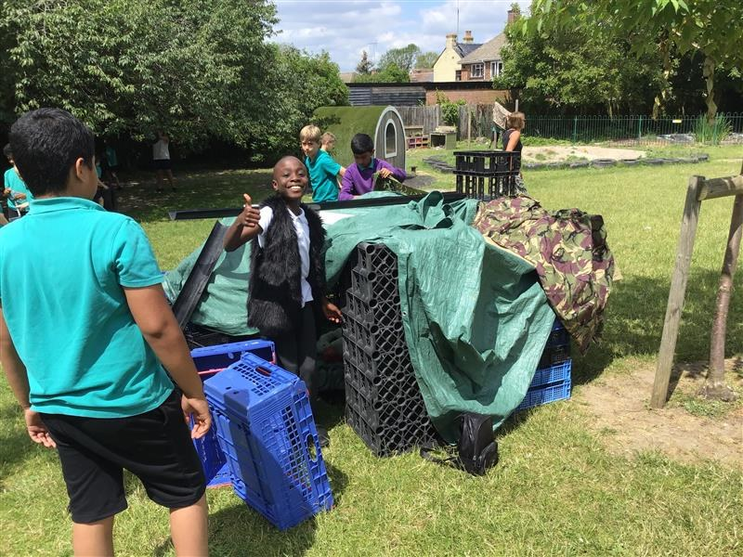
OPAL
OPAL lunches – watch this space! Come and see the playtimes and have lunch with us.
There are lots of activities available.
Waterproofs and wellies!

Slide 6
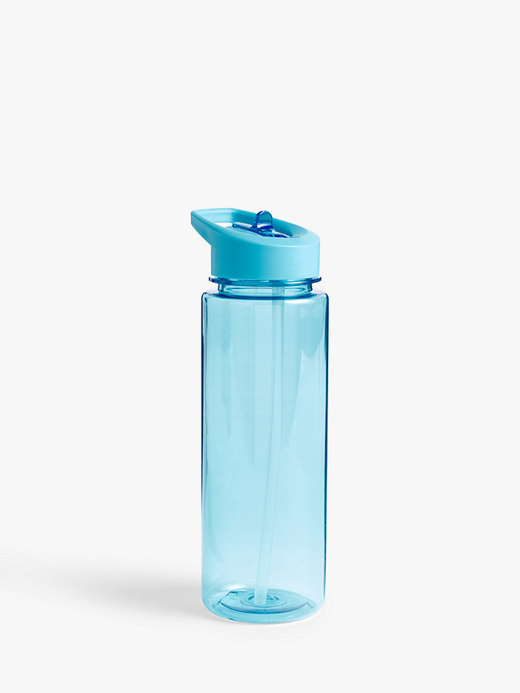
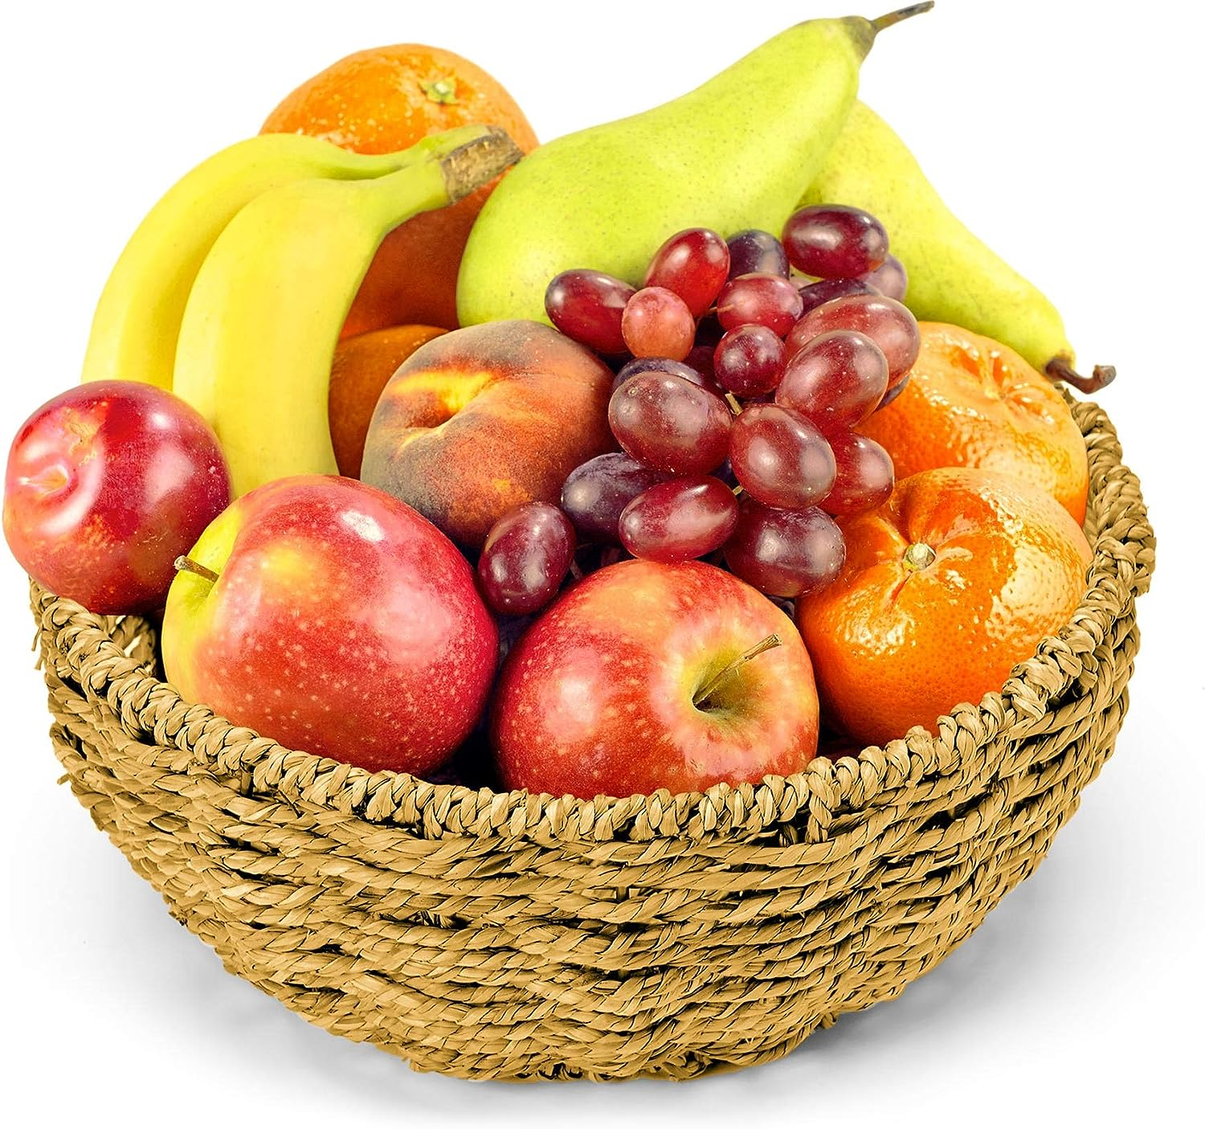
Healthy schools
Everyone must bring their own water bottle to and from school each day. Water only please.
Morning snack must be healthy, e.g. a piece of fruit, vegetable sticks or dried fruit.
No chocolate or sweets (may be brought in as a birthday treat)
We are a citrus and nut free school.

Slide 7
PE days:
Lapland Class –
Wednesday and Thursday
Adriatic Class –
Monday and Wednesday
Caribbean Class –
Wednesday and Thursdays

Slide 8
In year 1, we are looking forward to…
Termly visits to Fulbourn Nature Reserve
Young V and A Museum
Visit to a local beach
Woburn Safari Park
We are always looking for volunteers

Slide 9
Planners
Planners must be brought to and from school every day.
Signed by the class teacher and parent every week.
Record of house points, reading record, home learning, spellings.
Important reference resource in lessons.

Slide 10
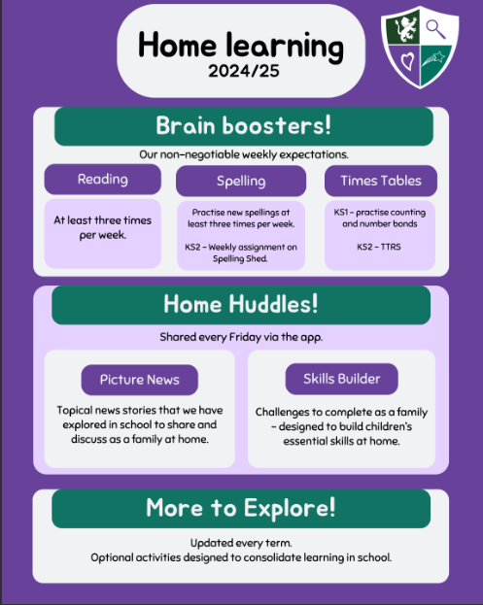

Slide 11
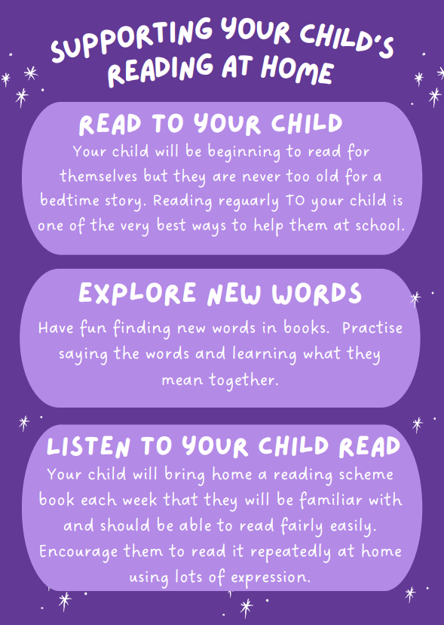
KS1 Reading habits

Slide 12
Phonics Screening Check
40 words – containing a mixture of real words and pseudo words.
Check is designed to give us information on how your child is progressing in phonics.
Results of the screening will be shared with you in the end of year report.
Phonics Screening Workshop

Slide 13
Communication
New app – platform for sharing updates and trip information etc.
School website – where to find key learning information

Slide 14
Thank you.
We look forward to working with you this year!

