Slide 1

Success in Early Years
2024 - 25

Slide 2
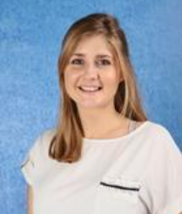
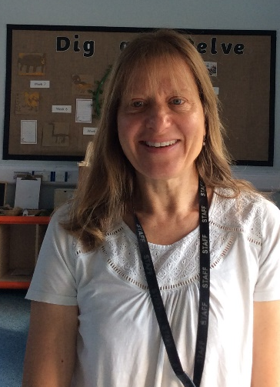
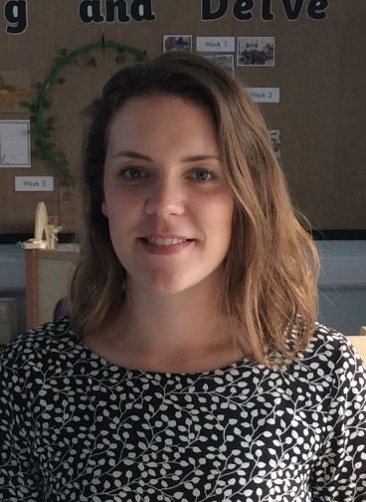
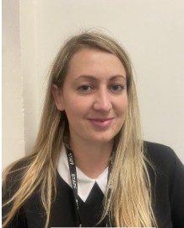
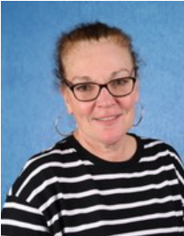
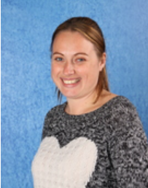
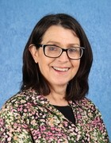
The EYFS Team
Ali Richman
Lapland Class Teacher
(Mon-Wed)
Libby Meyer
Lapland Class Teacher
(Thurs-Fri)
Sarah Horsman
Greenland Class Teacher and EYFS/KS1 Lead
Devon Trevillion Tami Gold Amanda Bell Emer Peyton
PPA staff: Dan Brinsdon (music) and Jamie Browne (PE)

Slide 3

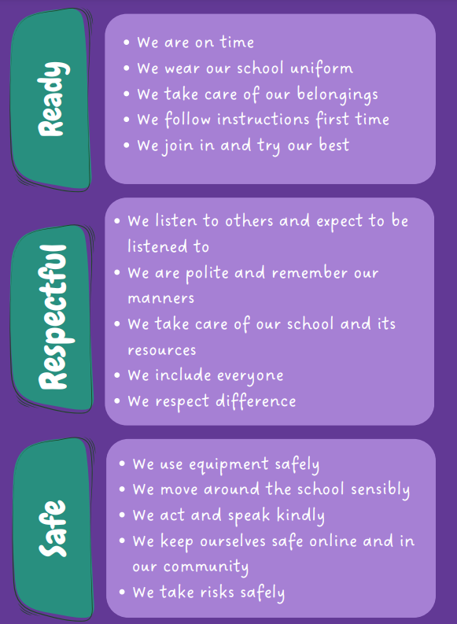

Slide 4
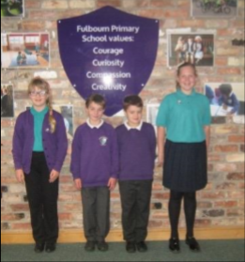

Uniform
Purple jumper and jade green or white shirt – no hooded jumpers
Grey or black skirt, dress or trousers
Plain black trainers/shoes
Wrist watches are welcome (no smart watches please).
Earrings must be studs (and must be removed for PE)
All playtimes are outside, even if it’s raining, so please provide waterproofs and a spare pair of shoes/wellies.
Please label everything!

Slide 5
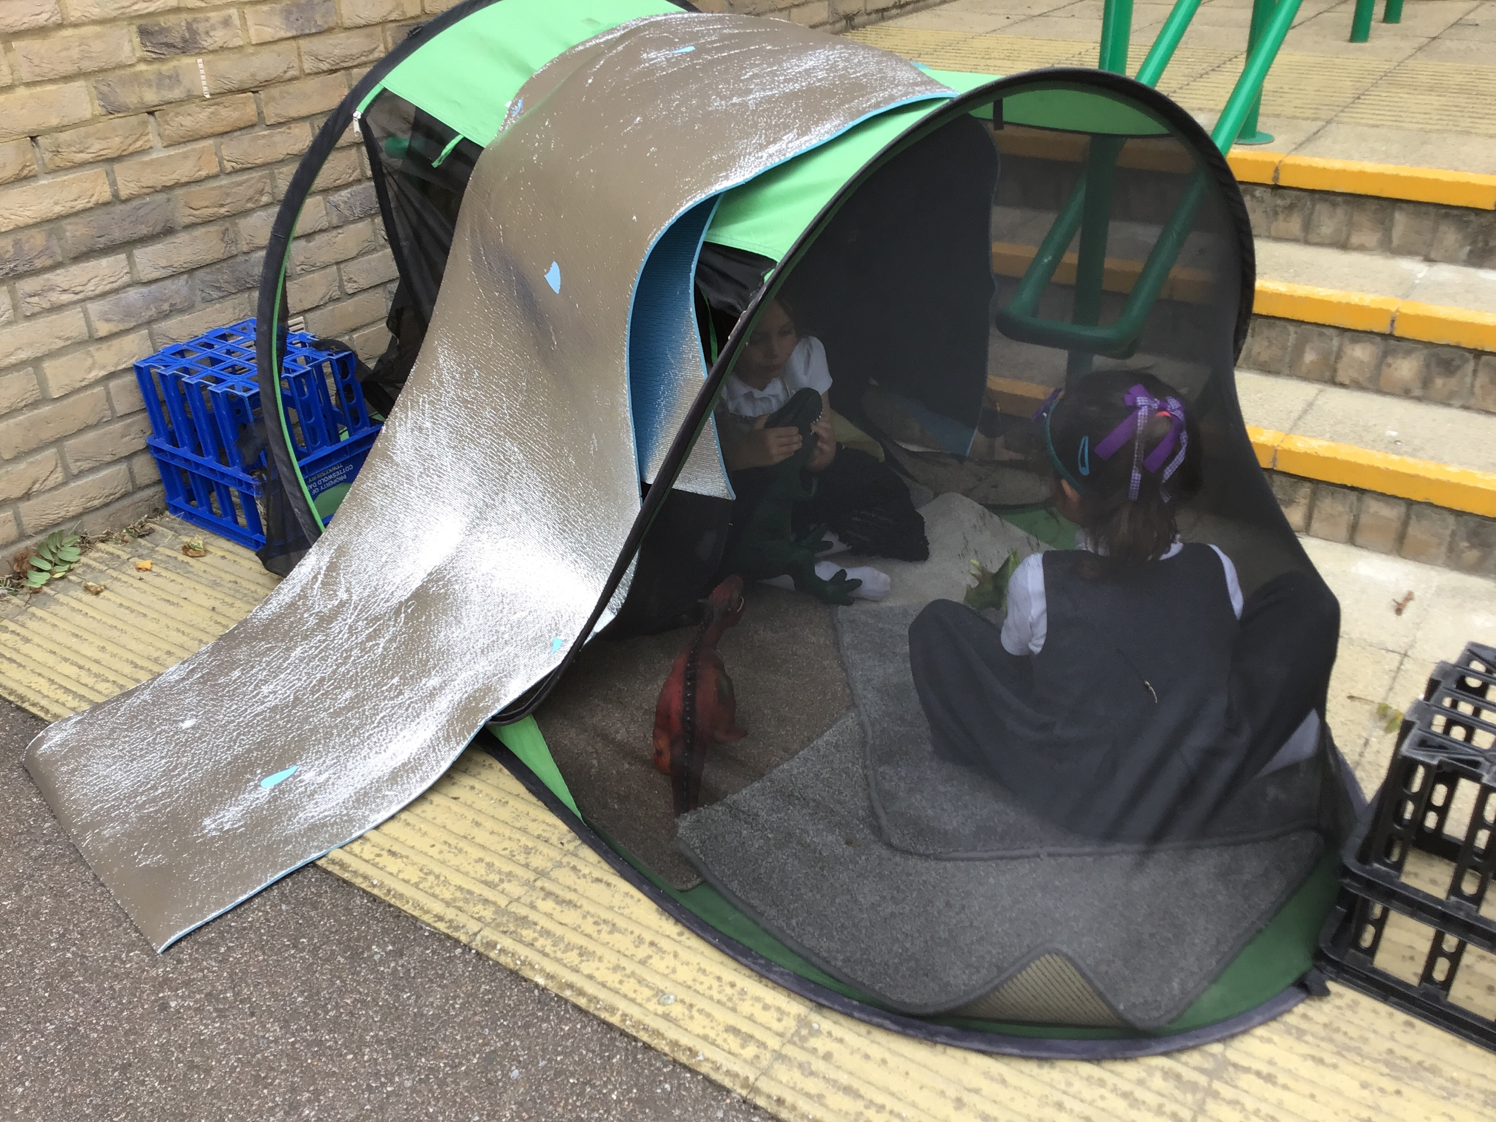
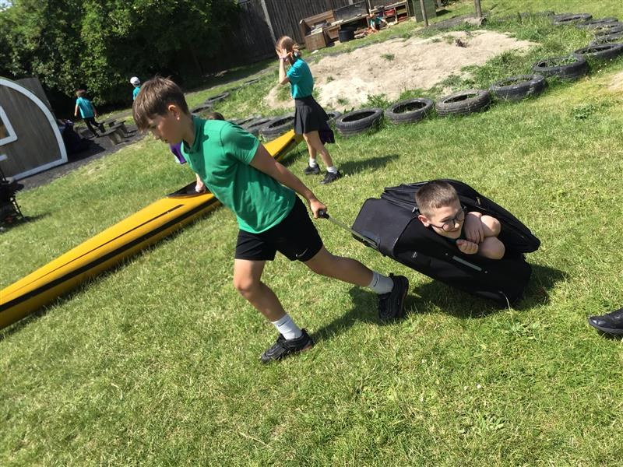
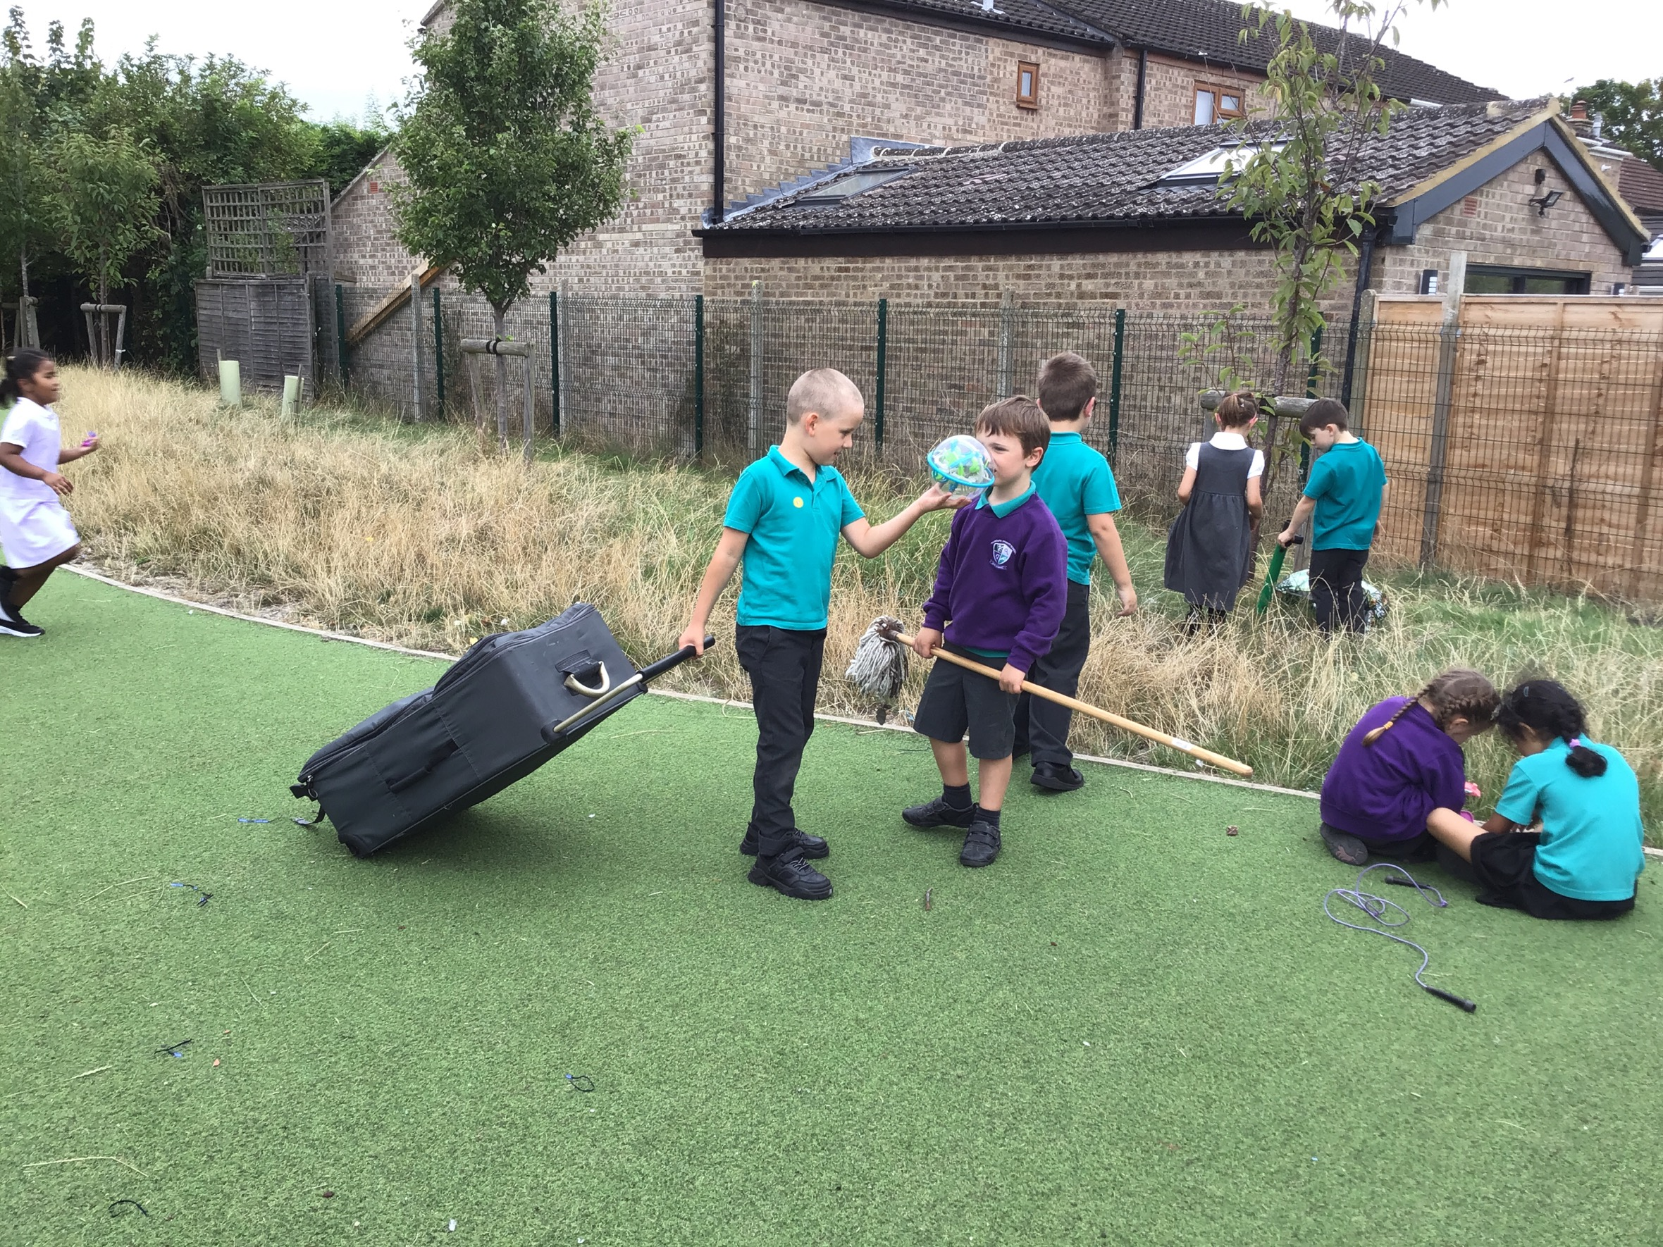
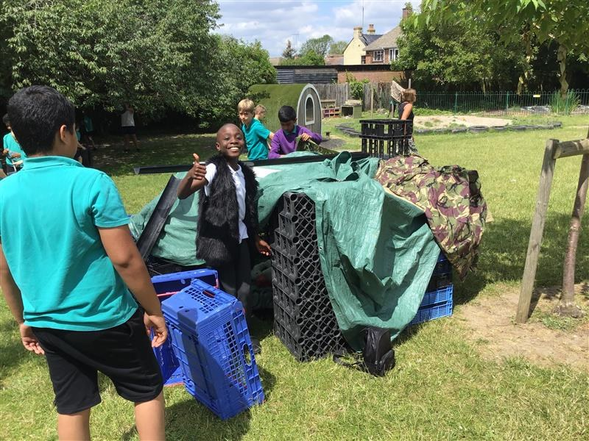
OPAL
OPAL lunches – watch this space! Come and see the playtimes and have lunch with us.
There are lots of activities available.
Waterproofs and wellies!

Slide 6
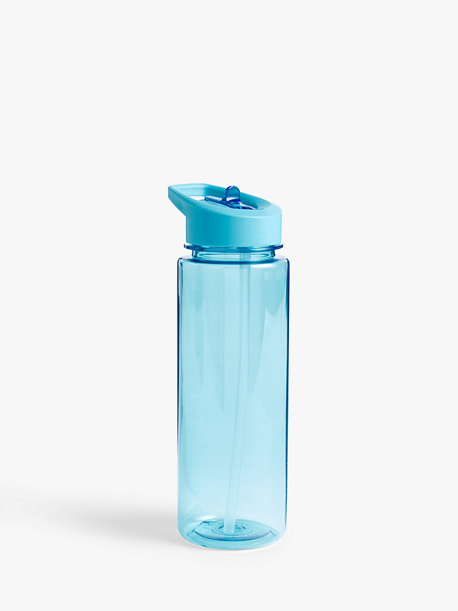

Healthy schools
Everyone must bring their own water bottle to and from school each day. Water only please.
Morning snack must be healthy, e.g. a piece of fruit, vegetable sticks or dried fruit. (Provided by school)
No chocolate or sweets (may be brought in as a birthday treat)
We are a citrus and nut free school.

Slide 7
PE days:
Lapland Class –
Wednesday and Thursday
Greenland Class –
Wednesday and Thursday

Slide 8
In EYFS, we are looking forward to…
Termly visits to Fulbourn Nature Reserve
Bury St Edmunds Theatre Trip
Visit to a local beach
Woburn Safari Park
We are always looking for volunteers

Slide 9
Celebrations
4C stickers and House Points
Class Pom Poms (10 pom pom treat)
Verbal Praise
Learning Explorer Certificates
Termly 4C certificates

Slide 10
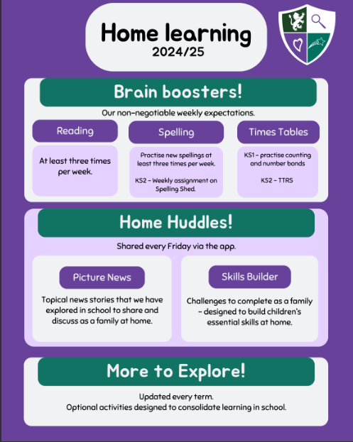

Slide 11
Weekly Updates
Weekly update on phonics, maths and topic activities
Suggested Activities

Slide 12

EYFS Reading habits

Slide 13
Reading Records
Reading books and reading records must be brought to and from school every day.
Comment by class teacher or teaching assistant each week.
Families should sign the record each time they read at home.
Form of communication between home and school about reading development.

Slide 14
Communication
New app – platform for sharing updates and trip information etc.
School website – where to find key learning information

Slide 15
Thank you.
We look forward to working with you this year!

