Slide 1
Teach reading: change lives
Parent workshop: Moving on from Phonics
Notes:
For this presentation, you will need to download and print out the following resources and information for parents:
the parent handout ‘Your child’s reading journey – Year 1’
‘Grow the code’ chart/mat
‘Phase 5 tricky words: Year 1 – Information for parents and carers' – or parents can access this in the ‘For parents’ area of the Little Wandle website.
You will need also need:
a flipchart
word cards to show how children spot digraphs in words; use two words with the same digraph, e.g. ‘head’ and ‘bread’
access to the Little Wandle and Collins websites
a copy of the Little Wandle Glossary (in Getting started/Teaching).

Slide 2
A love of reading is the biggest indicator of future academic success.
OECD (The Organisation for Economic Co-operation and Development)
Notes:
Slide purpose:
To share the link that research has established between loving reading and being successful academically
Suggested script:
Let's start our session with a quote from the Organisation for Economic Co-operation and Development ...
Read the quote.
This quote reminds us of the importance not just of teaching children to read, but also of teaching them to love reading.
Today, we're going to talk about phonics, but we always see phonics as the route into reading and a love of reading as the ultimate goal of phonics teaching.

Slide 3




How many times have you already read today?
Notes:
Slide purpose:
To help parents see the value of reading by getting them to reflect on their own reading experiences
Suggested script:
Just think about how many times you have already read things today. More than ever, we are surrounded by text and reading is a vital skill.
We want all of our children to become confident readers who can navigate the world of reading around them.

Slide 4

Phonics

Slide 5
Phonics is:
making connections between the sounds of our spoken words and the letters that are used to write them down.
Notes:
Slide purpose:
To give a a simple definition of phonics
Suggested script:
As you will remember from last year ...
Read the slide.
It sounds complicated but it really isn’t!
Let's review some of the important words that will help you understand phonics ...

Slide 6
Terminology
Phoneme
Blend
Grapheme
Segment
Digraph
Adjacent consonant
Trigraph
Split digraph
Notes:
Slide purpose:
To give simple definitions of key terminology
Suggested script:
Review what each word means – use the Glossary to help.
Children will have already learned most of these terms. In Year 1, split digraphs are introduced.

Slide 7


The progression
Notes:
Slide purpose:
To provide an overview of the progression children have followed from Reception, and into Year 1
Suggested script:
Your child has learned Phases 2, 3 and 4 in Reception (seen on the left).
Now they are in Year 1, they will have a brief review of Phases 3 and 4 and all of the Reception tricky words.
By week 4 of the first half term, they will begin phase 5.
Phase 5 covers the last remaining graphemes of the Little Wandle progression and alternative pronunciations and spellings of graphemes learned.

Slide 8
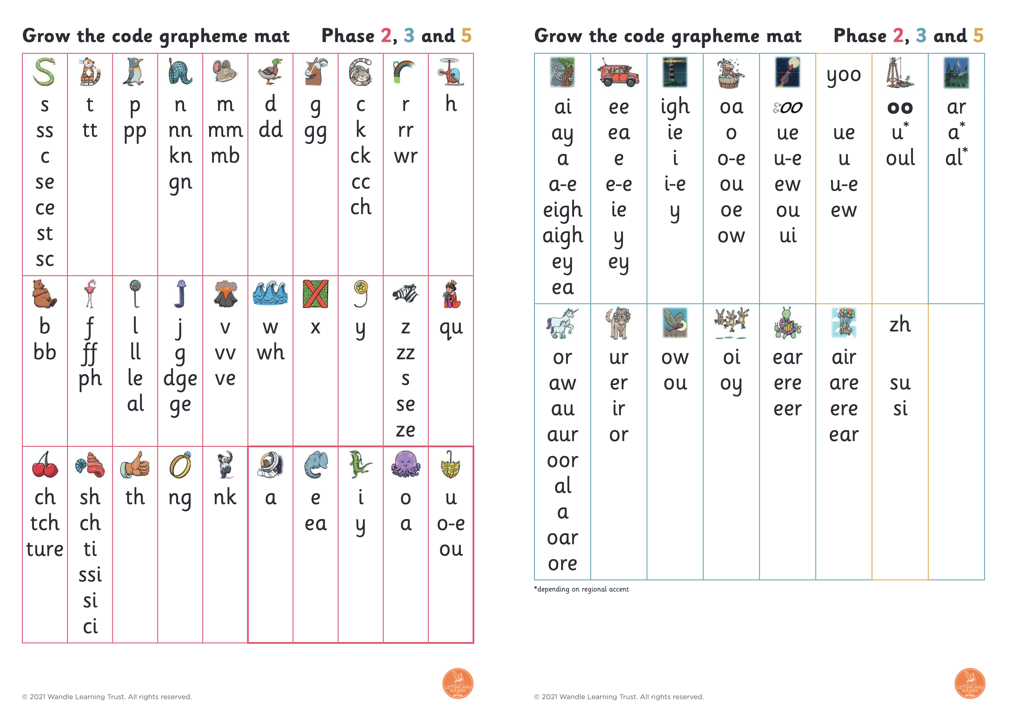
A complex code…
How do you write the sound /or/?
Born
Claw
Launch
Dinosaur
Door
Talk
Roar
More
Call
We use the beginning of Year 2 to embed their knowledge of alternative graphemes and pronunciations.
Notes:
Slide purpose:
To introduce the Phase 5 GPCs and how to say them
Suggested script:
Let's have a look at the Phase 5 sounds.
Hand out the Phase 5 handout and the ‘Grow the code’ mat.
Play the video and pause it so the parents can say the sounds if you wish.
Or display the ‘Grow the code’ chart and teach the parents the sounds.
Have a look at your handout and watch this video/look at the ‘Grow the code’ chart on the screen.
Now, let's have a practice!

Slide 9
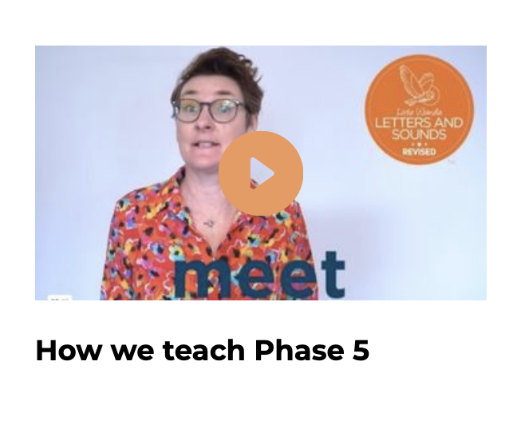
Best Bets
https://www.littlewandlelettersandsounds.org.uk/resources/my-letters-and-sounds/whole-school-cpd/how-to-videos/#tabnametabYear1
This is one method that we use to support your child to select the correct grapheme when writing.
Notes:
Slide purpose:
To provide an overview of Phase 5 'Grow the code’
Suggested script:
The children learn the last set of graphemes, including ones with alternative pronunciations.
Play the video which explains how we teach Phase 5. (The first 20 seconds are a repeat of the ‘How to say the sounds’ video but then goes on to explain what the alternative graphemes are for the sound /ai/.)
They will also learn to ‘Grow the code’ where children will explore different ways of spelling the same phoneme and reading the same grapheme. This means that they are able to read increasingly challenging words and books.
Children learn strategies so that they can distinguish between the same grapheme, different phoneme and the same phoneme but different grapheme. ‘Growing the code’ will support children as they get older with accurate spelling.

Slide 10
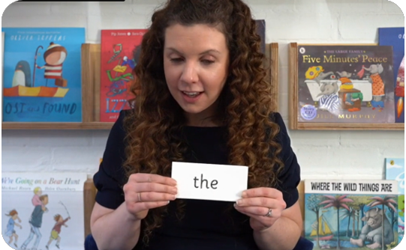
Tricky words:
have unusual spellings e.g. all, people
are taught in a systematic way.
Children are learning to read and w Phase 5 tricky words.
Notes:
Slide purpose:
To provide an overview of Year 1 tricky words
Suggested script:
Tricky words have unusual spellings. For example ‘all' is tricky to children in Reception because the letter ‘a’ says /or/ in this word.
Tricky words are taught in a systematic way, following the clearly defined Little Wandle sequence of learning. We teach them because they are common words that children need to know.
As children 'Grow the code', some tricky words will no longer be tricky. For example, children learn in Year 1 that the letter ‘a’ can make the /or/ sound in words like ‘all’, ‘ball’ and ‘water’’. This means that the word ‘all’ is no longer tricky!

Slide 11
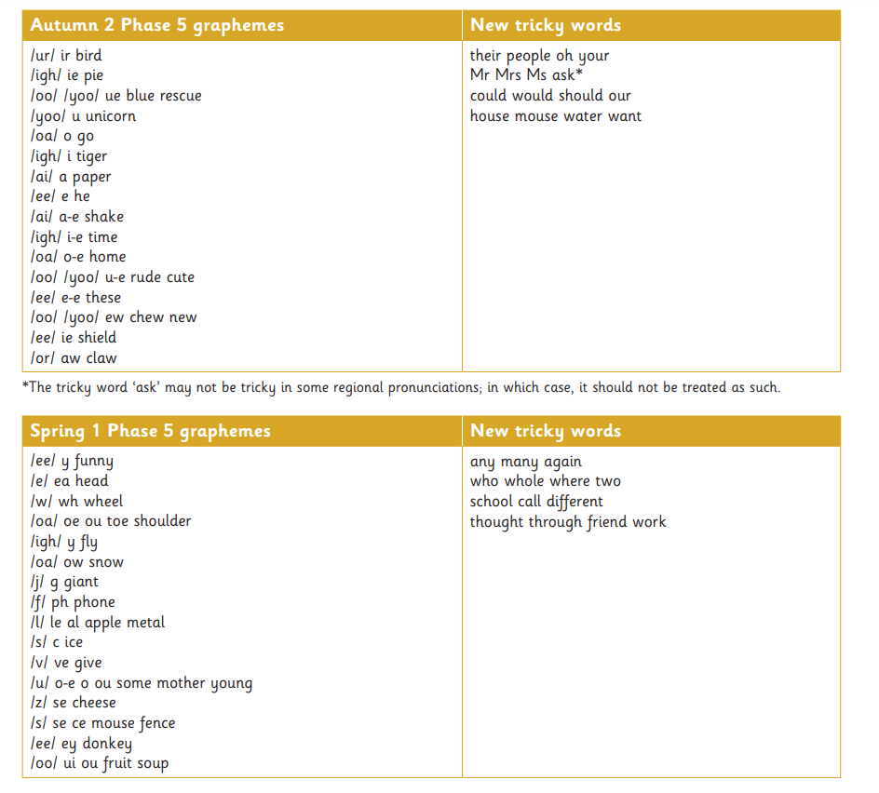
Phase 5 tricky words
Notes:
Slide purpose:
To provide an overview of Year 1 tricky words
Suggested script:
Here is an example of Year 1 tricky words.
We might not teach all of these words due to regional pronunciations e.g. ‘ask’. [Only say this if it is applicable to your setting].
You may wish to give parents a copy of the document ‘Phase 5 tricky words: Year 1 – Information for parents and carers'.

Slide 12
Reading in year 2

Slide 13
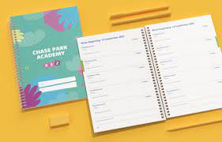
Please bring books and planners in every day

Slide 14

Decodable Reading books
Children will continue reading decodable (Big Cat) books until they are able to read these fluently.
We continue reading 3x PW in reading practice sessions until they are fluent.
They will also bring a reading for pleasure book for you to read to them.

Slide 15

Little Gems and Beyond
Little Gems are specifically designed, early chapter books.
In school, we use these as a bridge to selecting their own reading books entirely independently.
Books will no longer be changed on a Friday but as and when they finish their current book.
Children will read in pairs or threes and will decide together how much to read at home.
Children no longer need to re-read their book 3x with an adult.

Slide 16
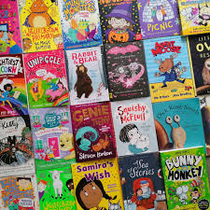
Beyond Little Gems…
After Little Gems, your child will begin selecting their own chapter book. This will be supported by an adult. We will still hear them read, but no longer in a group.
Books will no longer be changed on a Friday but as a when they finish their current book.
Please listen to your child read 3x pw for about fifteen minutes a day, this is the most important support you can give at home.
Please still use their planners to let us know they have read.

Slide 17
How do I help my child read a Chapter Book?
As ever, listening to your child read and talking to them about their book is the most important thing you can do to support your child at home. Read for about 15 minutes, three times a week with your child.
You could:
• Talk about some of the interesting vocabulary you find
• Discuss the characters – what impression do you get of them?
• Predict what might happen next
• Talk about the author and if they have read or heard of them before?
• Jot down something you discussed with your child in their planner

Slide 18

Transition to spelling

Slide 19

Spelling
Children will continue with phonics until they are confident to read and write using phase 5 sounds.
After this (usually around half term), children will begin learning spellings.
Phonics is foundational in teaching spellings, however, spelling rules and word structure begin to be taught more explicitly.
We use Spelling Shed to teach spellings.
Notes:
Slide purpose:
To introduce spelling
Suggested script:
In Year 1, there are increasingly challenging words to spell, e.g. longer words, compound words, plurals. This all matches the Little Wandle sequence of learning.
The children will also practise writing a dictated sentence on a Friday. Their teacher will say the sentence, show them how to write it and then ask the children to write it independently.
Handwriting phrases learned in Reception are referred to during the lesson, but the specific practice of handwriting is taught separately.

Slide 20
Research has shown that learning to spell is much more than just memorising a list of words.
.
Spelling Shed helps children develop their language skills, so they learn HOW to spell, not just a list of words.
chunks of meaning
morphology
letter-sound links
phonics
letter patterns
orthography
memorised words
visual memory
where words come from
etymology

Slide 21
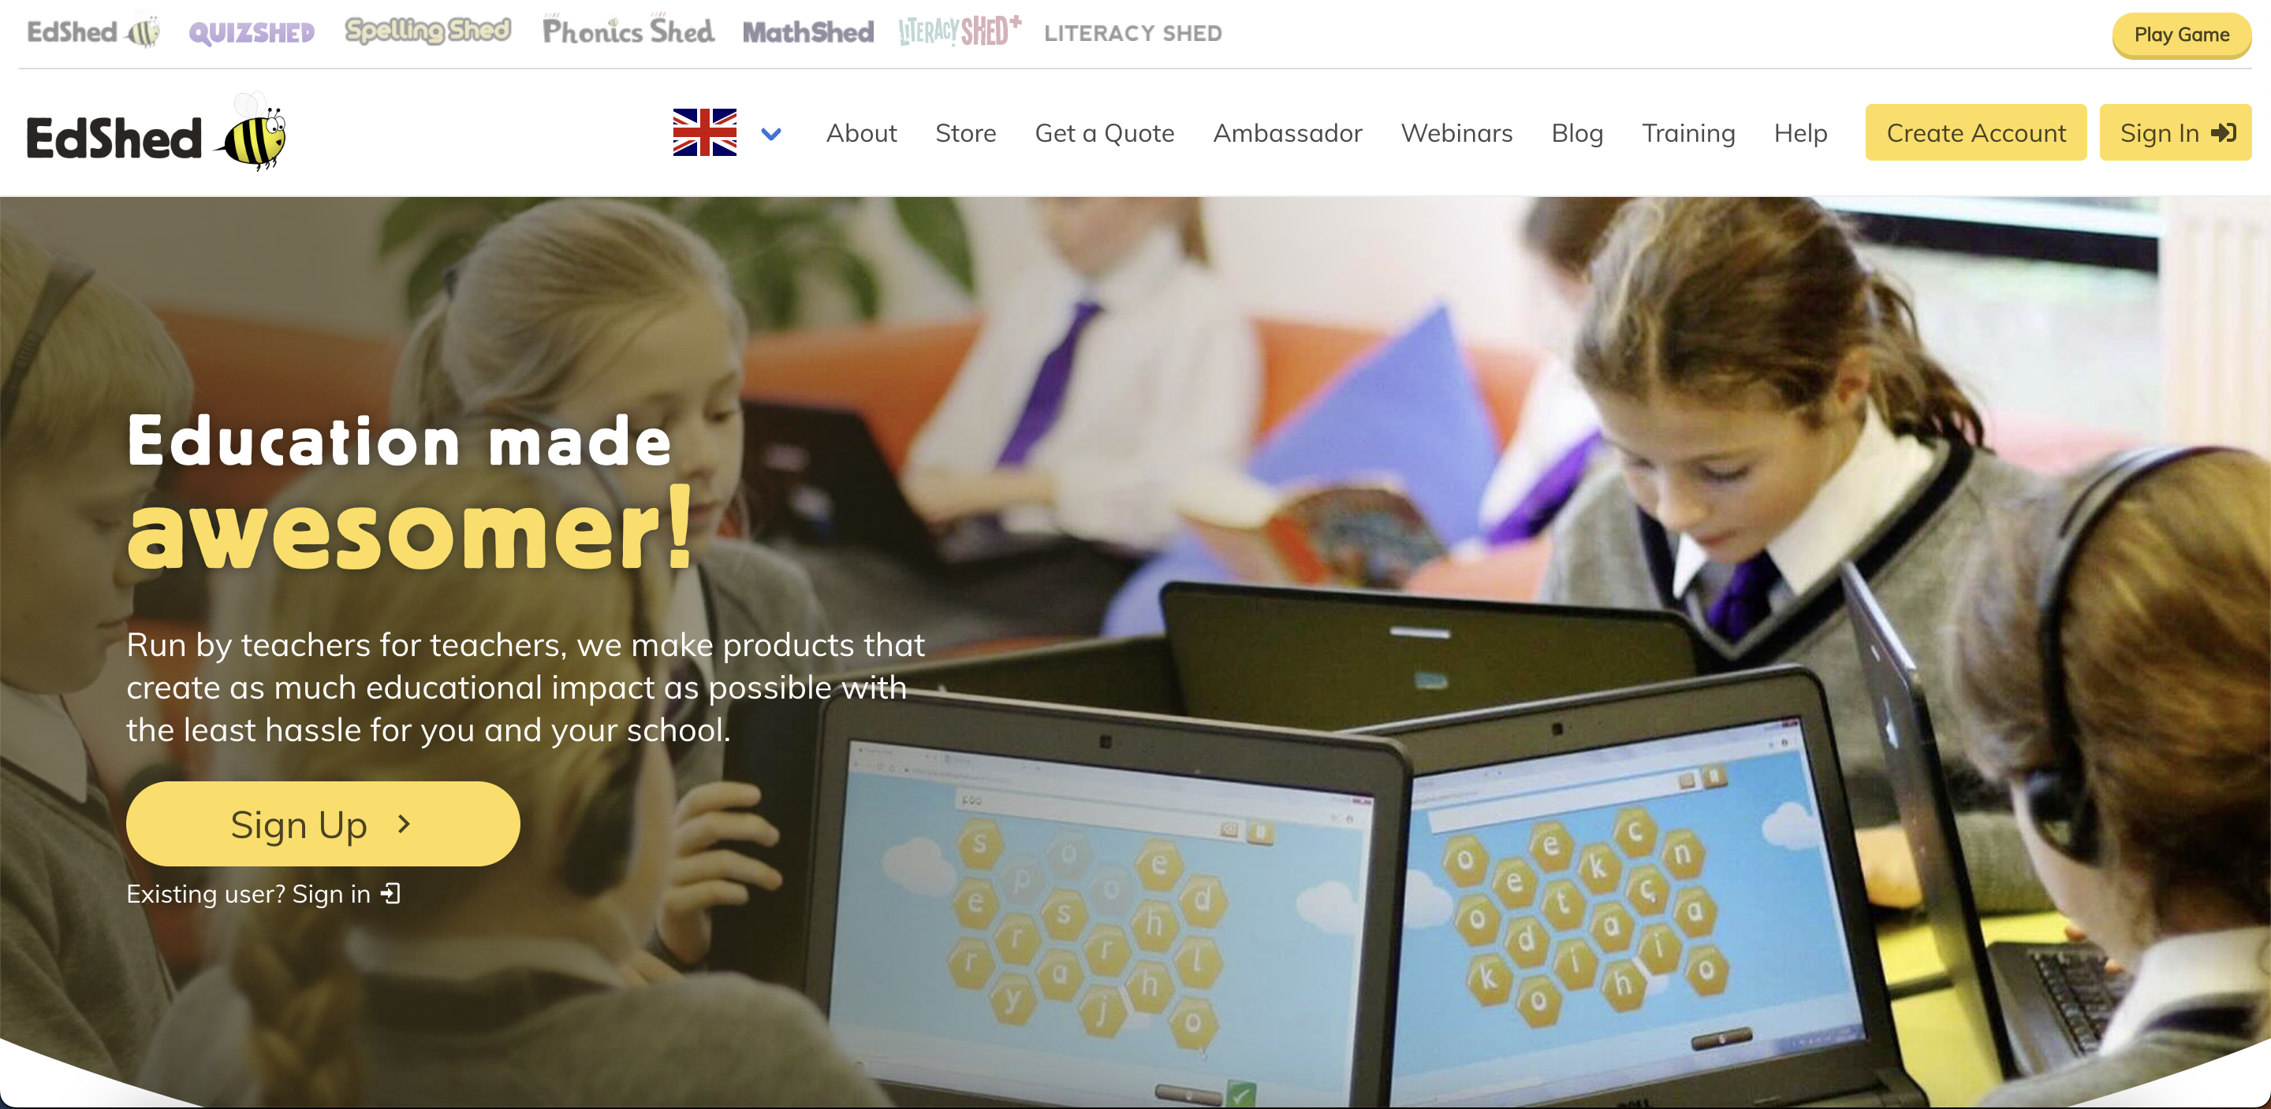
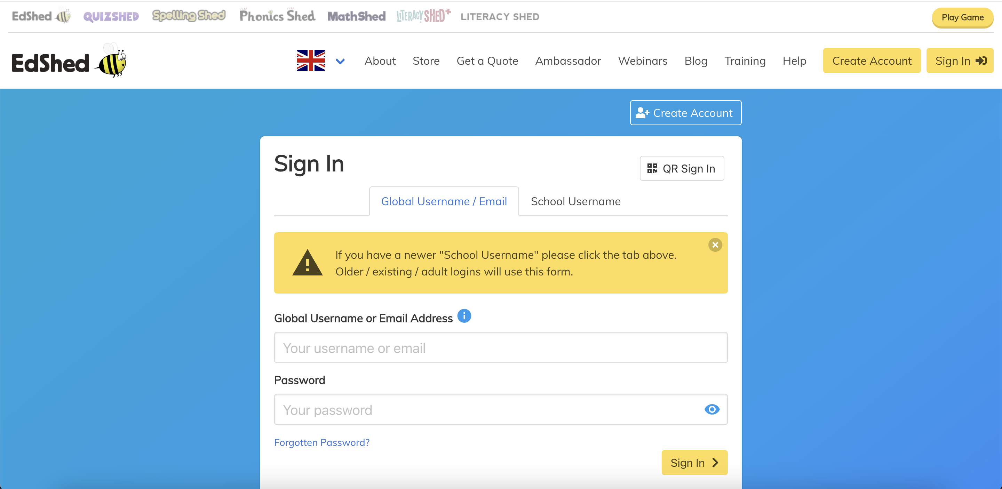
How To Use Spelling Shed
Notes:
1. Go to www.edshed.com
2. Press Sign In – you don’t need to create an account as this will be done by us at school.
3. This is where you input the login details.

Slide 22
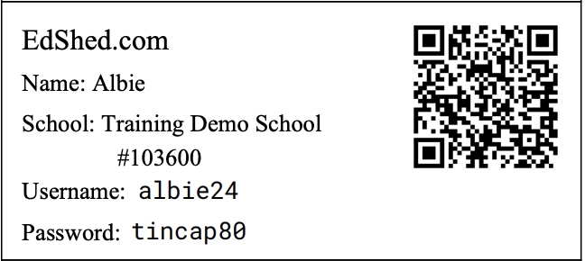
When we move to spelling shed, you will be given a log in.
You will also be given a parent guide which will support you to log in.
Spellings will continue to be stuck in planners
If preferred, you can practise spellings using paper- just jot this down in their planner so that we can keep track of their practise.

Slide 23
One of the greatest gifts adults can give is to read to children
Carl Sagan
Notes:
Slide purpose:
Key takeaway/final message
Suggested script:
Read the quote.
Working together will ensure that your children become skilled readers.

